Slide 1


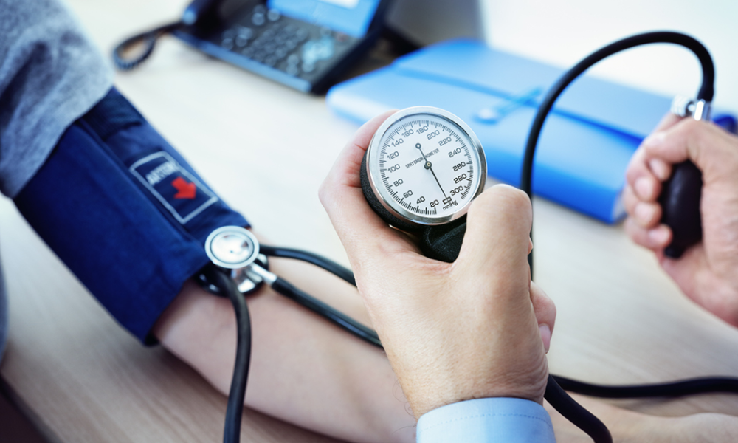
Fundamentals of Nursing(1st Stage)
Blood pressure
And pulse
(practice)
Lecture 4
University of Basrah –College of Nursing – Fundamentals of Nursing Department

Slide 2
Definitions
Blood pressure: is the force exerted by the blood against the vessel walls.
Systolic blood pressure: the peak pressure occurs when the heart’s ventricular contraction, or systole, forces blood under high pressure into the aorta.
Diastolic blood pressure: when the ventricles relax, the blood remaining in the arteries exerts a minimum or diastolic pressure. diastolic pressure is the minimal pressure exerted against the arterial wall at all times.
University of Basrah –College of Nursing– Fundamentals of Nursing Department
2

Slide 3
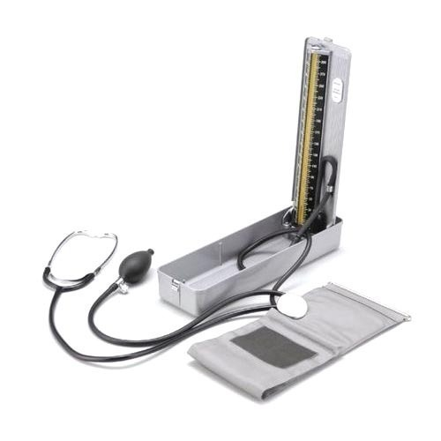
*The standard unit for measuring BP is millimeters of mercury (mm Hg).
*most common technique of measuring BP is auscultation using sphygmomanometer and stethoscope.
University of Basrah –College of Nursing– Fundamentals of Nursing Department
3

Slide 4
Classification of blood pressure
Diastolic BP ((mmHg | Systolic BP (mmHg ) | Category
<80 mmHg | <120 mmHg | Normal
80 – 89 | 120 - 139 | Pre-hypertension
90 – 99 | 140 - 159 | Stage 1
≥ 100 mmHg | ≥ 160 mmHg | Stage 2
University of Basrah –College of Nursing– Fundamentals of Nursing Department
4

Slide 5
Hypertension: is a systolic blood pressure of 140 mm Hg or greater, diastolic blood pressure of 90 mmHg or greater.
Hypotension: is generally considered present when the systolic blood pressure fall to 90 mm Hg or below.
systolic BP less than 100 mmHg
diastolic BP less than 60 mmHg
University of Basrah –College of Nursing– Fundamentals of Nursing Department
5

Slide 6
Common Mistakes In Bp Assessment
Effect | Error
false low reading | Bladder or cuff too wide
false high reading | Bladder or cuff too narrow or too short
false high reading | Cuff wrapped too loosely
false high diastolic reading | Deflating cuff too slowly
false low systolic and false high diastolic reading | Deflating cuff too quickly
University of Basrah –College of Nursing– Fundamentals of Nursing Department
6

Slide 7
Effect | Error
false high reading | Arm below heart level
false low reading | Arm above heart level
false high reading | Arm not supported
University of Basrah –College of Nursing– Fundamentals of Nursing Department
7

Slide 8
Equipment
1-Sphygmomanometer
2- Stethoscope
3- Alcohol swab
4- Pen, vital signs flow sheet
University of Basrah –College of Nursing– Fundamentals of Nursing Department
8

Slide 9
Nursing Diagnosis
Ineffective tissue perfusion.
Deficit fluid volume.
Decreased cardiac output.
University of Basrah –College of Nursing– Fundamentals of Nursing Department
9

Slide 10
Implementation
Perform hand hygiene.
With client sitting or lying position client’s forearm supported if needed at heart level, with palm turned up. If sitting client should be instructed to keep feet flat on floor without legs crossed.
Exposure upper arm fully by removing constricting clothing.
Palpate brachial artery, position cuff ( 2.5 cm) above site of brachial pulsation.
Position manometer vertically at eye level.
Measured BP by:
Place stethoscope earpieces in ears and be sure sounds are clear .
Place diaphragm of stethoscope over brachial artery.
University of Basrah –College of Nursing– Fundamentals of Nursing Department
10

Slide 11
C. Close valve of pressure bulb clock wise until tight. Quickly inflate cuff to 30 mmHg above client’s usual systolic pressure.
D. Slowly release pressure bulb valve and note point on monometer when first clear sound is heard ( systolic pressure).
E. Continue to deflate cuff gradually, noting point at which sound disappears ( diastolic pressure) .
7. Remove cuff from client’s arm .
8. Assist client in returning to comfortable position and cover upper arm.
9. Perform hand hygiene .
University of Basrah –College of Nursing– Fundamentals of Nursing Department
11

Slide 12

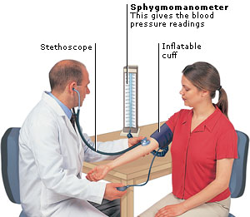
University of Basrah –College of Nursing– Fundamentals of Nursing Department
12

Slide 13
Assessing Radial pulse
Radial pulse : The ejection of blood from the heart distends the walls of the aorta.
Because of the force of the blood exiting the heart, aortic distention creates a pulse wave that travels rapidly to ward the extremities.
When the pulse wave reaches a peripheral artery, it can be felt by palpating the artery lightly against underlying bone or muscle.
The pulse is the palpable bounding of the blood flow.
University of Basrah –College of Nursing– Fundamentals of Nursing Department
13

Slide 14
The number of pulsing sensations occurring in 1 minute is the pulse rate.
Pulse rate , rhythm , and strength indirectly evaluate the heart’s cardiac output (CO).
An abnormally slow, rapid, or irregular pulse may indicate the heart’s inability to deliver an adequate cardiac output; a pulse deficit may be present.
The strength or amplitude of a pulse reflects the volume of blood ejected against the arterial wall with each heart contraction, also called stroke volume (SV).
University of Basrah –College of Nursing– Fundamentals of Nursing Department
14

Slide 15
If the heart’s stroke volume decreases, the pulse often becomes weak and difficult to palpate.
In contrast, a full bounding pulse is an indication of increased stroke volume.
The radial artery pulse is the most common peripheral site for pulse rate assessment.
The carotid artery site is also commonly used when the radial pulse is weak or difficult to palpate.
Other peripheral pulses are assessed when a complete physical is conducted or when the radial artery is not available for assessment because of (surgery, trauma, or impaired blood flow.
University of Basrah –College of Nursing– Fundamentals of Nursing Department
15

Slide 16
Pulse Sites
Rationale for Selection | Location | Site
Easily accessible site to assess pulse in children | Over temporal bone of head, above and lateral to the eyebrow | 1-Temporal
Easily accessible site to assess character of peripheral pulse, used during physiological shock or cardiac arrest when other sities are not palpable | Along medial edge of sternocleidomastoid muscle in the neck. | 2- Carotid
Site for auscultation of heart sounds | Fourth to fifth intercostal space at left midclavicular line | 3- Apical
Site used to ausculate upper extremity blood pressure, assesses status of circulation to lower arm | Groove between biceps and triceps muscle at the antecubital fossa | 4- Brachial
Common site to assess character of peripheral pulse, assesses status of circulation to hand | Radial or thumb side of forearm at the wrist | 5- Radial
University of Basrah –College of Nursing– Fundamentals of Nursing Department
16

Slide 17
Rationale for Selection | Location | Site
Site used to assess status of circulation to ulnar side of hand, usedto perform Allen’s test | Ulnar side of forearm at the wrist | 6- Ulnar
Site used to assess character of pulse during physiological shock or cardiac arrest when other pulses are not palpable , assess status of circulation to the lge | Below the inguinal ligment , midway between symphysis pubis and anterior superior iliac spine | 7- Femoral
Site used to ausculate lower extremity blood pressure, assesses status of circulation to the lower leg | Behind the knee in popliteal fossa | 8- Popliteal
Site used to assess status of circulation to the foot | Inner side of each ankle,below medial malleolus | Posterior tibial 9-
Site used to assess status of circulation to the foot | Along top of foot between extension tendons of great and first toe | pedis 10- Dorsalis
University of Basrah –College of Nursing– Fundamentals of Nursing Department
17

Slide 18
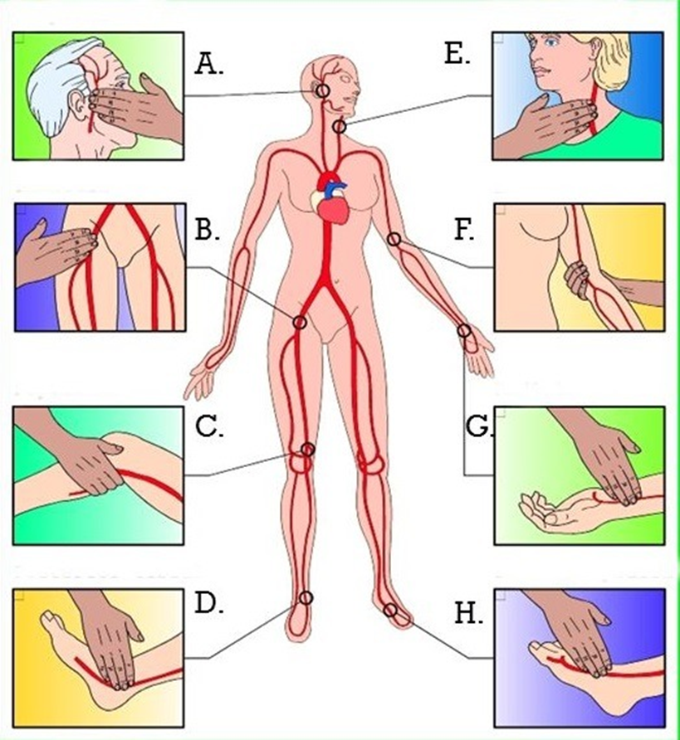
University of Basrah –College of Nursing– Fundamentals of Nursing Department
18

Slide 19
Equipment
1-wrist watch second hand or digital display.
2-pen, pencil, vital sign flow sheet or record form.
University of Basrah –College of Nursing– Fundamentals of Nursing Department
19

Slide 20
Nursing diagnosis
Activity intolerance
Decreased cardiac output
Deficient fluid volume
Ineffective peripheral tissue perfusion
University of Basrah –College of Nursing– Fundamentals of Nursing Department
20

Slide 21
Implementation
1.Perform hand hygiene.
2. If necessary, draw curtain around bed and/or close door.
3. Assist patient with assuming a supine or sitting position.
4. If patient is supine, place his or her forearm straight alongside or across lower chest or upper abdomen with wrist extended straight .If sitting, bend patient’s elbow 90 degrees and support lower arm on chair or on nurse’s arm. Place tips of first two or middle three fingers of hand over groove along radial or thumb side of patient’s inner wrist .Slightly extend or flex wrist with palm down until you note strongest pulse.
5. Lightly compress against radius, obliterate pulse initially, and relax pressure so pulse becomes easily palpable.
University of Basrah –College of Nursing– Fundamentals of Nursing Department
21

Slide 22
6. Determine strength of pulse. Note whether thrust of vessel against fingertips is bounding (4+); full increased, strong (3+); expected (2+); barely palpable, diminished (1+); or absent, not palpable (0).
7. After palpating a regular pulse, look at watch second hand and begin to count rate. Count the first beat after the second hand hits the number on the dial; count as one, then two, and so on.
8. If pulse is regular, count rate for 30 seconds and multiply total by 2.
9. If pulse is irregular, count rate for a full 60 seconds. Assess frequency and pattern of irregularity.
10. Perform hand hygiene.
University of Basrah –College of Nursing– Fundamentals of Nursing Department
22

Slide 23
Assessing Apical pulse
The apical pulse rate is the assessment of the number and quality of apical sounds in 1 minute.
Each apical pulse is the combination of two sounds, S1 and S2.
S1 is the sound of the tricuspid and mitral valves closing at the end of ventricular filling, just before systolic contraction beings.
S2 is the sound of the pulmonic and aortic valves closing at the end of the systolic contraction.
University of Basrah-College of Nursing– Fundamentals of Nursing Department
23

Slide 24
Equipment
1-Stethoscope
2-wrist watch with second hand or digital display.
3-pen,pencil, vital sign flow sheet or record form
4-Alcohol swab.
University of Basrah –College of Nursing– Fundamentals of Nursing Department
24

Slide 25
Implementation
Perform hand hygiene.
If necessary, draw curtain around bed and/or close door.
Assist patient to supine or sitting position. Move aside bed linen and gown to expose sternum and left side of chest.
Locate anatomic landmarks to identify point of maximal impulse (PMI), also called apical impulse. The heart is located behind and to left of sternum with base at top and apex at bottom. Find angle of Louis just below suprasternal notch between sternal body and manubrium; it feels like a bony prominence. Slip fingers down each side of angle to find second intercostal space (ICS). Carefully move fingers down left side of sternum to fifth ICS and laterally to left midclavicular line (MCL). A light tap felt within area 1 to 2.5cm of PMI is reflected from apex of heart.
University of Basrah –College of Nursing– Fundamentals of Nursing Department
25

Slide 26
University of Basrah –College of Nursing– Fundamentals of Nursing Department
26

Slide 27
5. Place diaphragm of stethoscope over PMI at fifth ICS, at left MCL, and auscultate for normal S1 and S2 heart sounds (heard as “lub-dub”).
6. If apical rate is regular, count for 30 seconds and multiply by 2.
7. If HR is irregular or patient is receiving cardiovascular medication, count for a full 1 minute (60 seconds).
8. Replace patient’s gown and bed linen; help him or her return to comfortable position.
9. Perform hand hygiene.
10. Clean earpieces and diaphragm of stethoscope with alcohol swab routinely after each use.
University of Basrah –College of Nursing– Fundamentals of Nursing Department
27

Slide 28
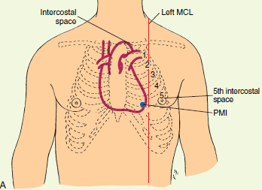
University of Basrah –College of Nursing– Fundamentals of Nursing Department
28

Slide 29

University of Basrah –College of Nursing– Fundamentals of Nursing Department
29

